Slide 1
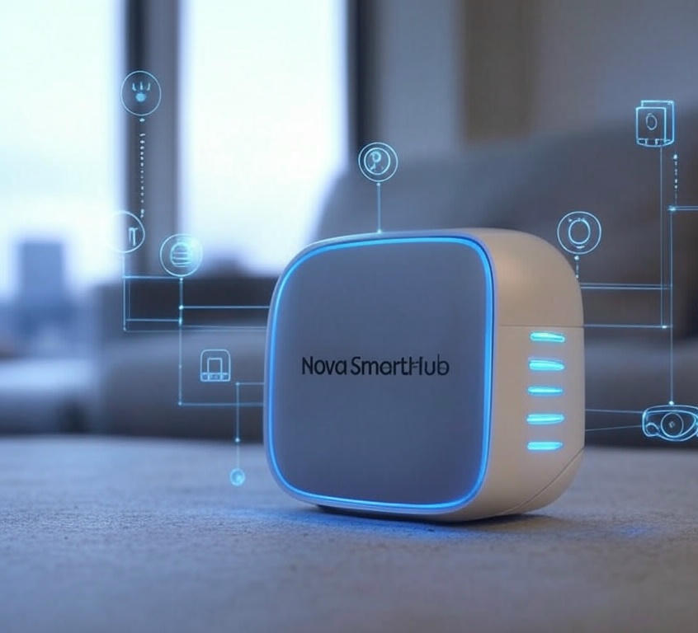
Introducing the Nova SmartHub
The Future of Connected Living

Slide 2

What to Expect Today
Welcome & Introduction
The Problem We’re Solving
Introducing the Nova SmartHub
Key Features & Benefits
Market Opportunity
Launch Timeline & Availability
Q&A

Slide 3
Why We Need a Change
Smart home devices are fragmented—too many apps, no seamless integration
Users crave simplicity without sacrificing functionality
Current solutions lack advanced AI personalization

Slide 4
Apr. 2025
Pre-orders open
June 2025
Shipping begins in North America
2025
Q3 2025: Global rollout (Europe, Asia)
2025
Q4 2025: Software update with new features
When Can You Get It?

Slide 5
"The Nova SmartHub: Connecting your world, intelligently."
Questions? Let’s discuss!
Follow us: @xTechInnovations on X
Thank You!

